Slide 1
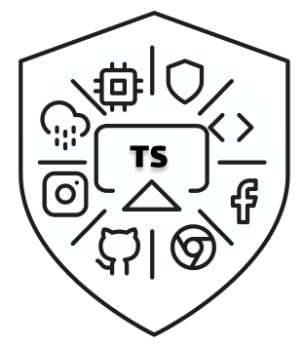
TRACK SYSTEM

Slide 2
Shield: This symbol generally represents protection and security, implying that the Track System is designed to safeguard data and processes.
Microprocessor: This icon suggests that the system is powered by advanced technology and computational capabilities.
Lock: This symbol reinforces the security aspect of the system, indicating that it has measures in place to prevent unauthorized access.
Cloud: This icon implies that the system might utilize cloud-based infrastructure for scalability and accessibility.
Social media icons (Instagram, Facebook, GitHub, Chrome): These icons suggest that the Track System might integrate with popular social media platforms or web browsers, potentially for user authentication, data sharing, or tracking activities.

Slide 3
Monitor and track activities: It might track user behavior, system performance, or external events.
Ensure security: It could implement measures to protect against unauthorized access, data breaches, and other security threats.
Improve efficiency: It might optimize processes, identify bottlenecks, and provide insights for improving performance.
Integrate with other systems: It might connect with other software or hardware components to enhance its functionality.
THANK YOU

Slide 4
TEAM MEMBERS:
ROHIT - PES2UG23CS819
KRISHAN - PES2UG22CS271
ARFA - PES2UG22CS315
G SPANDANA - PES2UG22CS195

